Slide 1
INSPIRE model: classic
[C] [0..n] CoupledResource
[?] ResourceLocator
[M] ResourceLocator
Service MD
Service GetCap
Dataset MD
[M] ExtCap/SpatialDatasetIdentifier
[?] ExtCap/metadataURL
collection
Data (Layer/Feature)
[?] metadataURL

Slide 2
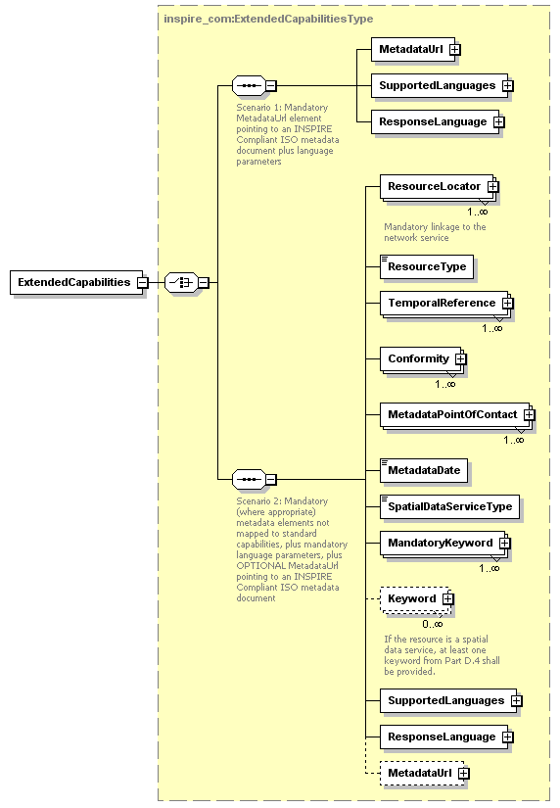
INSPIRE model: classic
Service Metadata: Scenario 1
Service GetCap
Service MD
[M] ResourceLocator
ExtendedCapabilities
[size=3]
[M] inspire_common:MetadataURL

Slide 3
INSPIRE model: classic
In the VW TG, the existence of the service MD is mandatory, regardless of the choosen scenario (1 or 2). It means a simple duplication of information between the service and its metadata
Service Metadata: Scenario 2 (based on VW TG)
Service GetCap (+)
Service MD
[M] ResourceLocator
ExtendedCapabilities
[size=n]
[O] inspire_common:MetadataURL

Slide 4
INSPIRE model: classic
In the DW TG, the existence of the service MD is NOT mandatory. It means that scenario 2 suggests you can avoid the creation of service MD, if you enrich the service itself with MD information.
Service Metadata: Scenario 2 (based on DW TG)
Service GetCap (+)
Service MD
[M] ResourceLocator
ExtendedCapabilities
[size=n]
[O] inspire_common:MetadataURL

Slide 5
INSPIRE model: simplified
[M] ResourceLocator
Service MD
Service GetCap (+)
Dataset MD
[O] ExtCap/SpatialDatasetIdentifier
collection
Data (Layer/Feature)
[M] metadataURL

Slide 6
INSPIRE model: simplified
Service Metadata: single scenario
Service GetCap (+)
ExtendedCapabilities
[size=n]

Slide 7
INSPIRE model: simplified
Dataset Metadata: ResourceLocator
Name
URL
Dataset MD
Description
ResourceLocator
ApplicationProfile
Protocol
Function (ISO restricted)

Slide 8
INSPIRE model: simplified
Dataset Metadata: ResourceLocator
Use of simple codelist (eg. “OGC:WFS”), without expressing versions and APIs
URL
Protocol
Function
ApplicationProfile
Name
Description

Slide 9
INSPIRE model: simplified
Dataset Metadata: ResourceLocator
Unused
URL
Protocol
Function
ApplicationProfile
Name
Description
Notes:
JRC agrees on dropping the use of Function

Slide 10
INSPIRE model: simplified
Dataset Metadata: ResourceLocator
Decide the features we associated to “download” and “view”.
Issue #17: it contains a proposal of using these values as specification of an URL that point to the “INSPIRE Get View/Download Service Metadata”
URL
Protocol
Function
ApplicationProfile
Name
Description

Slide 11
INSPIRE model: simplified
Dataset Metadata: ResourceLocator
Discussion on Antonio+Paul proposal, of using this field to pinpoint some “data element” (layer or feature) inside the service
URL
Protocol
Function
ApplicationProfile
Name
Description

Slide 12
INSPIRE model: simplified
Dataset Metadata: ResourceLocator
Discussion on the use of a specific codelist to distinguish the URL that give access to “GetCap” document.
Access Point VS Endpoint
URL
Protocol
Function
ApplicationProfile
Name
Description

